Slide 1
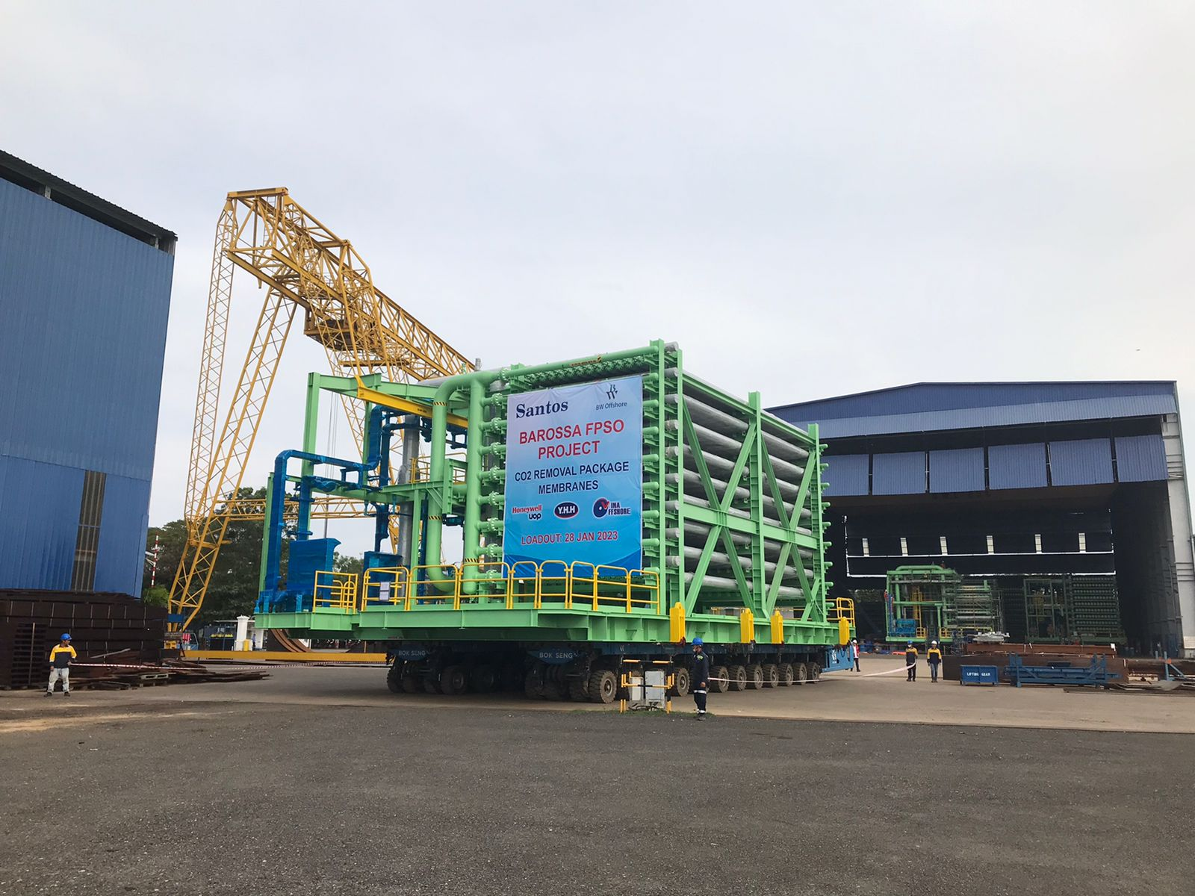

Vina Offshore
Engineering
Company
Presentation
<Revision 2025.02>

Slide 2
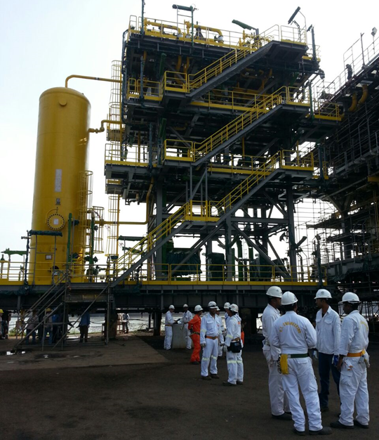
Company Overview
YHH Marine Engineering was established in Singapore in 2006.
It is the parent company of Vina Offshore Engineering in Vietnam – a specialized fabrication yard.
Vina Offshore has grown to become a major service provider in the Construction, Processing, Marine, Offshore and Onshore Oil & Gas industries.
It has expertise on Structural, Piping, Electrical & Instrumentation (E&I), Insulation and Manufacturing Works for Compressor & Process Skids, Metering Skids, Thermal Oxidizers, Burners, Flare Stacks, Top-side Modules for FPSO, Petrochemical Plants and others.

Slide 3

Quality and OH&S Policy
Continual improvement of our system for customer satisfaction.
Protect the health, safety and prevent injury & ill health of all persons working under control of Vina Offshore.
Comply with applicable legal requirements, other requirements and all relevant regulations related to safety and health at all times.
Openly communicate all OH&S issues to all persons working under control of Vina Offshore.
Ensure personnel who visit or work at clients’ sites must comply with their health and safety requirements.
Continually explore ways to improve OH&S management, performance and operations to reduce any known risks.

Slide 4



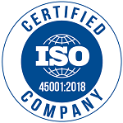
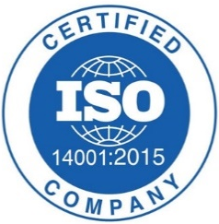


Certification & Accreditation
ISO 9001:2015
ISO 45001:2018
ISO 14001:2015
ASME & NBBI
ISO 3834-2 (CE-Marking Enabler)
EN 1090-1 (CE-Marking Enabler)

Slide 5

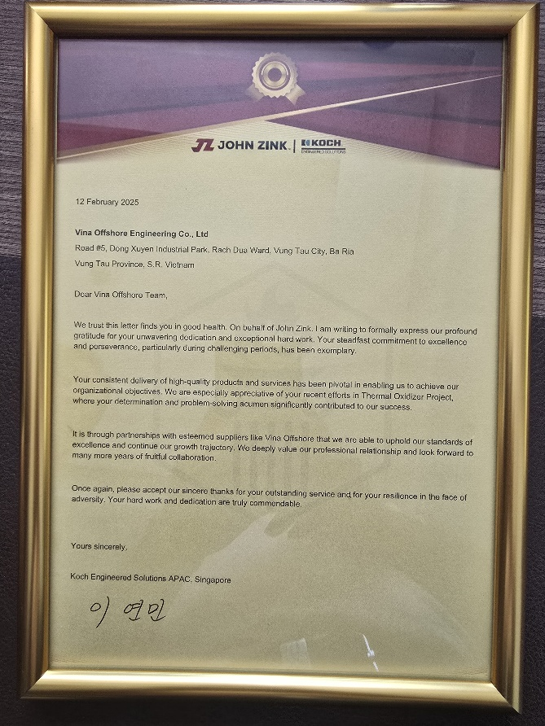

Special Recognition
“ ….. formally express our profound gratitude for your unwavering dedication and exceptional hard work ….. “
“ ….. your consistent delivery of high-quality products and services has been pivotal in enabling us to achieve our organizational objectives …..”

Slide 6
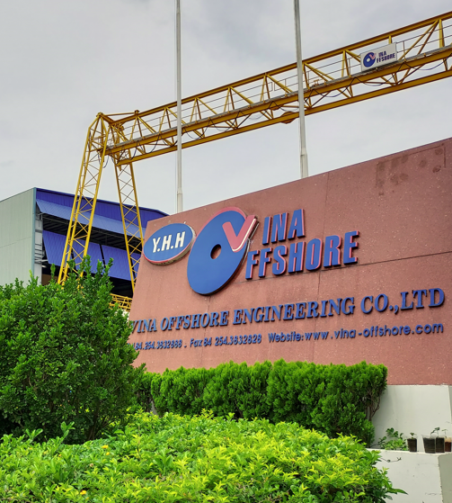
Vina Offshore Engineering
Leading fabrication and engineering company in Vietnam for Process Skids & Modules for the Marine, Offshore and Onshore Oil & Gas industries.
Established in 1995 and 100% owned by Singapore’s Y.H.H Marine Engineering since 2015.
Purpose-built fabrication and engineering complex in Vung Tau (part of Ho Chi Ming City).
Strategically located at the water edge with a load-out facility of 10 MT/ m² and 10,000 DWT jetty.
Land Area: Over 60,000 m² .
Workforce: Over 200.

Slide 7
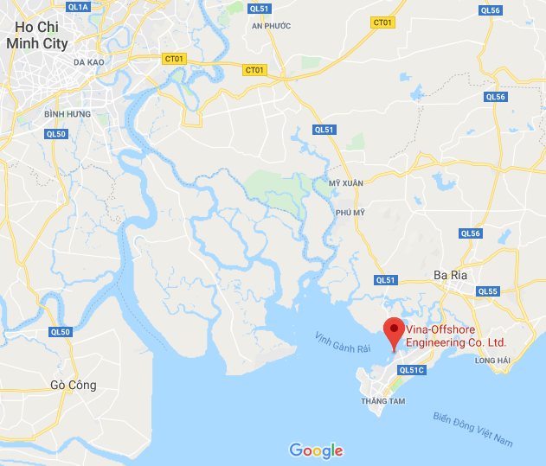
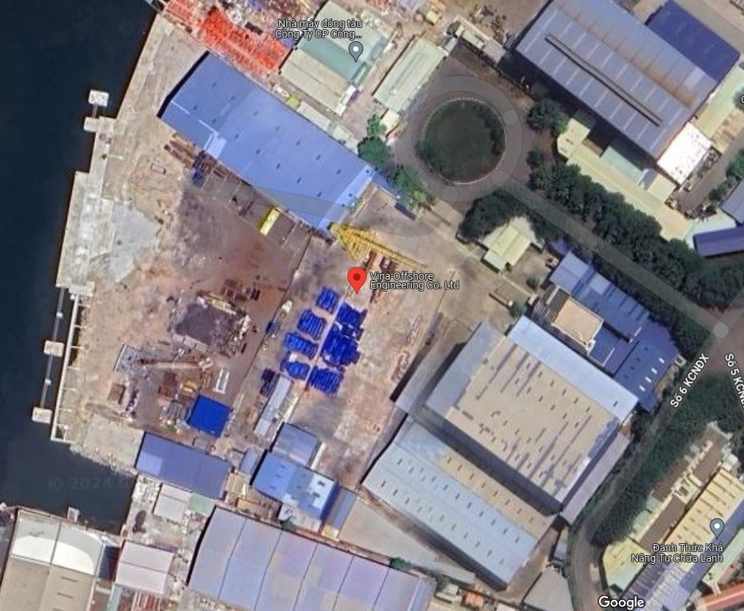
Vina Offshore - Vung Tau, Vietnam
Approx. 95 km
Area: 60,000 m²
Ground Loading Capacity: 6N/cm² (60T/m²)

Slide 8
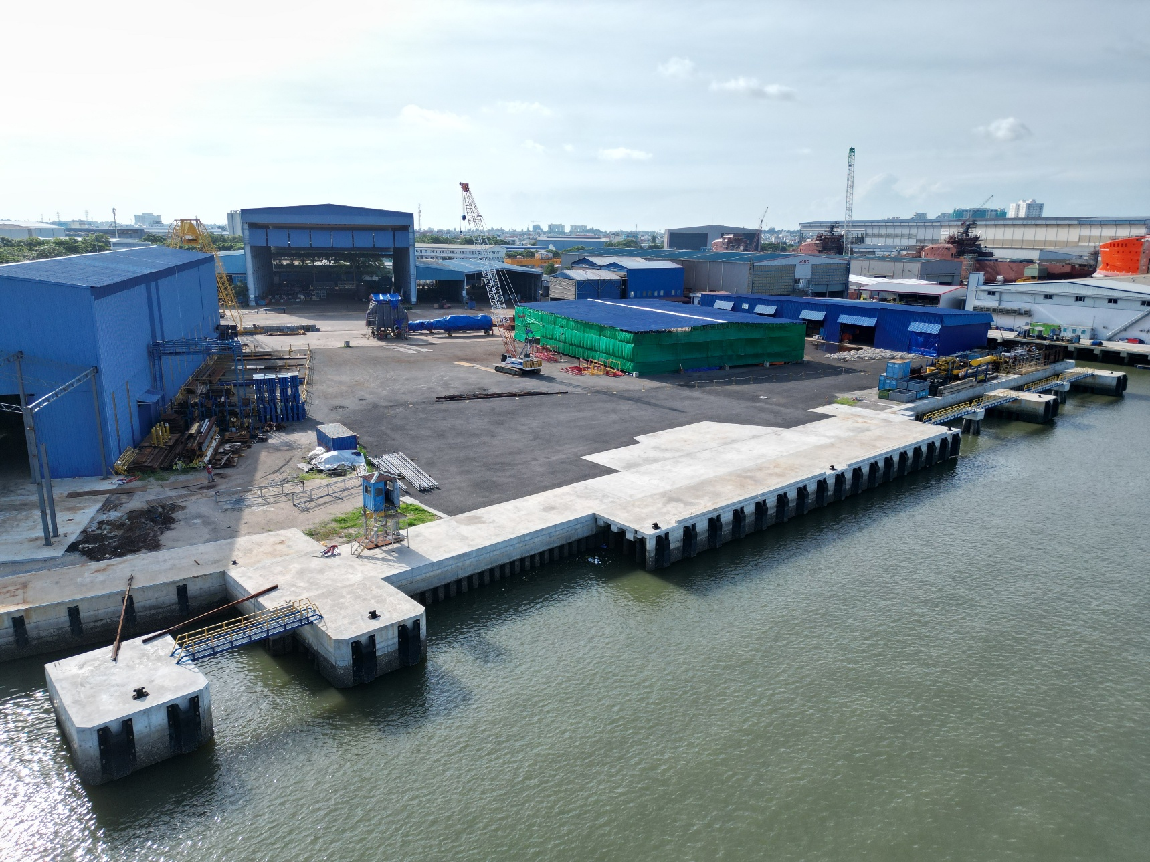
Vina Offshore - Port Details
Port Code: VNXTS
Port Name: Vina Offshore
Port Capacity: 10,000 DWT*
Mooring Capacity: Vessel Load Capacity of 10,000 DWT
Jetty at Vina Offshore
Jetty Length: 122m
At Zero Tide: 6.0m
Navigation Channel
At Low Tide: 5.0m to 5.5m
At High Tide: 8.0m to 8.5m
* As Designated

Slide 9
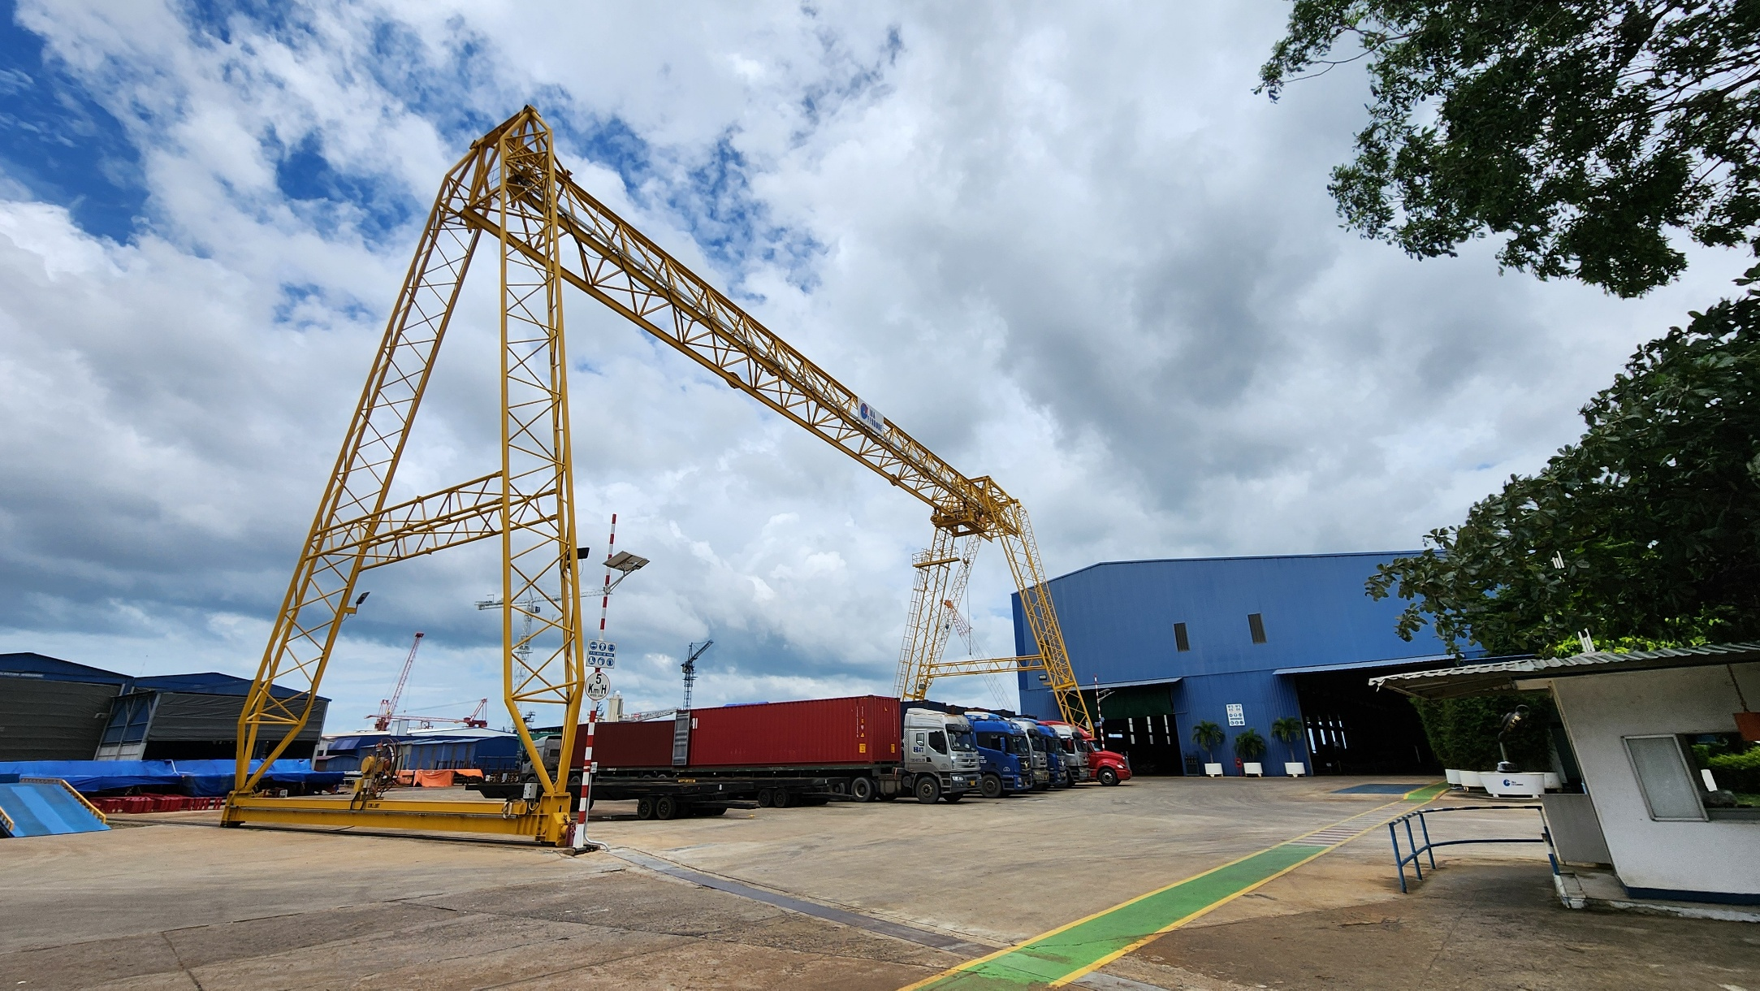
Vina Offshore - Open Area
20T Gantry Crane

Slide 10
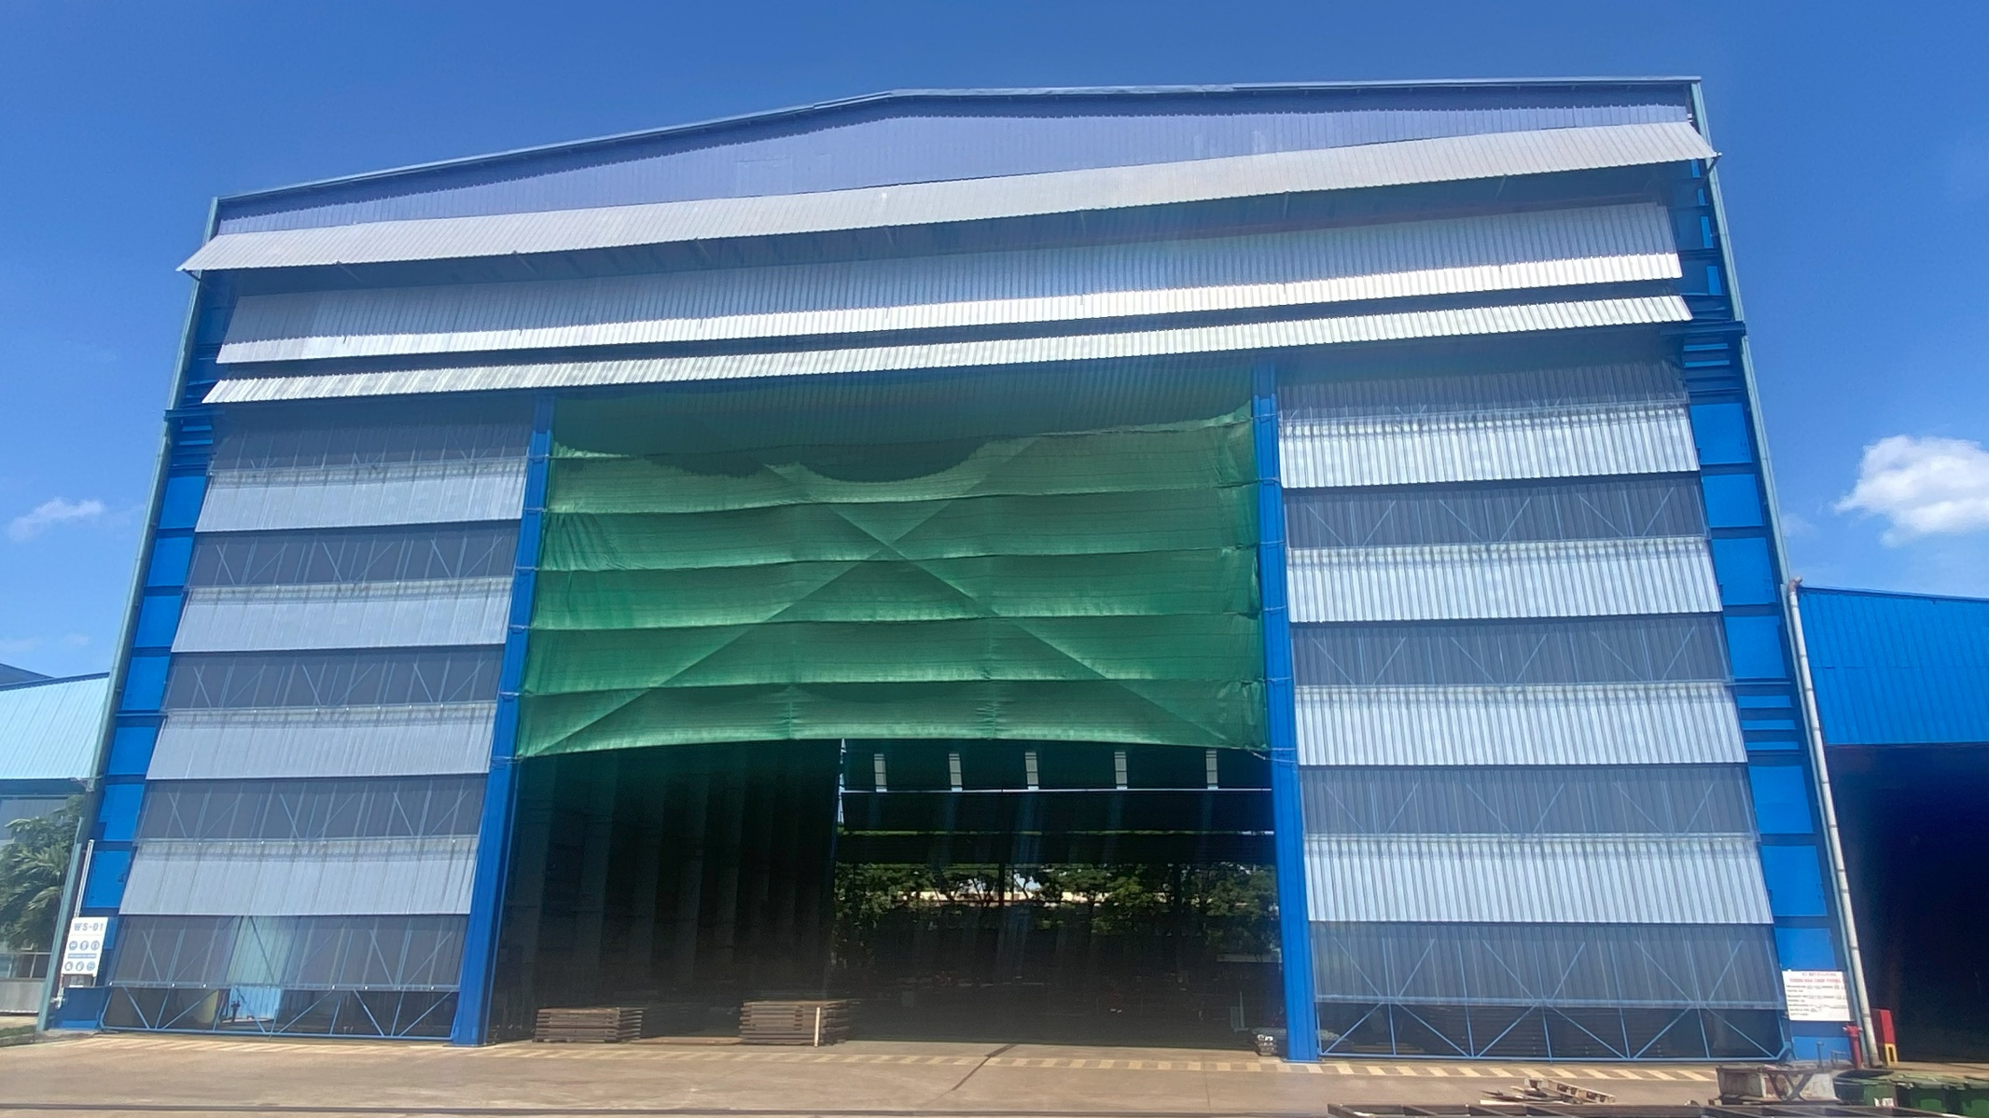
Vina Offshore - Workshop No. 1
Size: 48m (W) x 80m (L) x 23m (H)
Overhead Crane: 2 x 25T

Slide 11
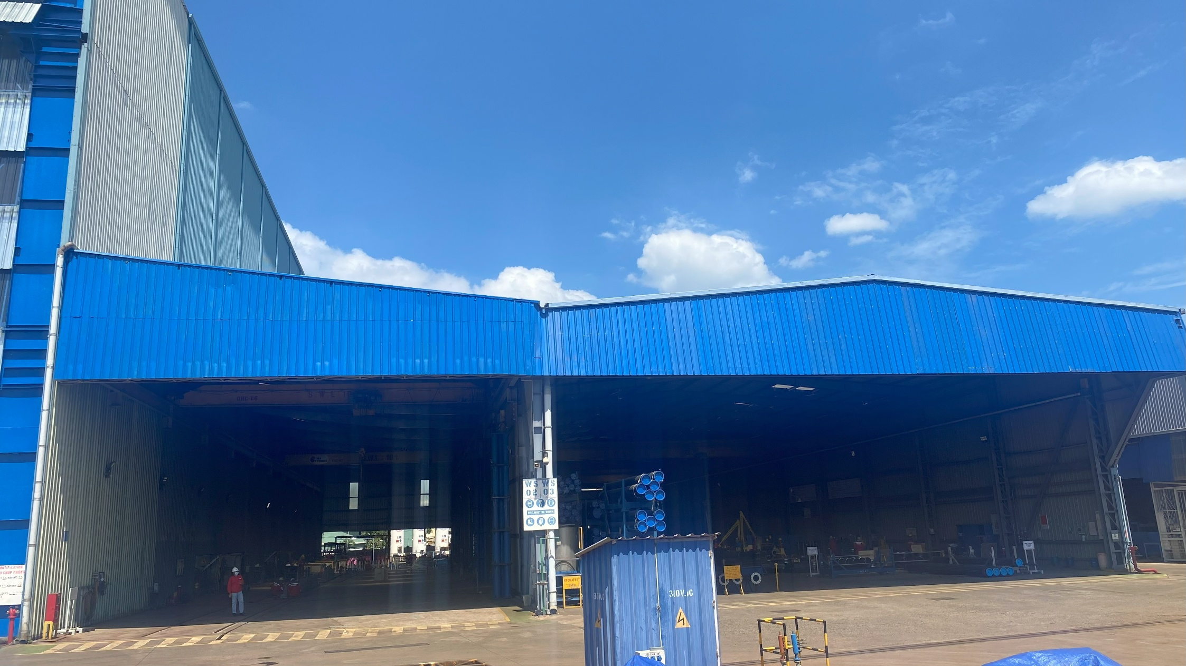
Vina Offshore - Workshop No. 2 & 3
Workshop No. 2
Size: 15m (W) x 80m (L) x 9m (H)
Overhead Crane: 2 x 10T
Workshop No. 3
Size: 25m (W) x 80m (L) x 9m (H)
Overhead Crane: 2 x 10T

Slide 12
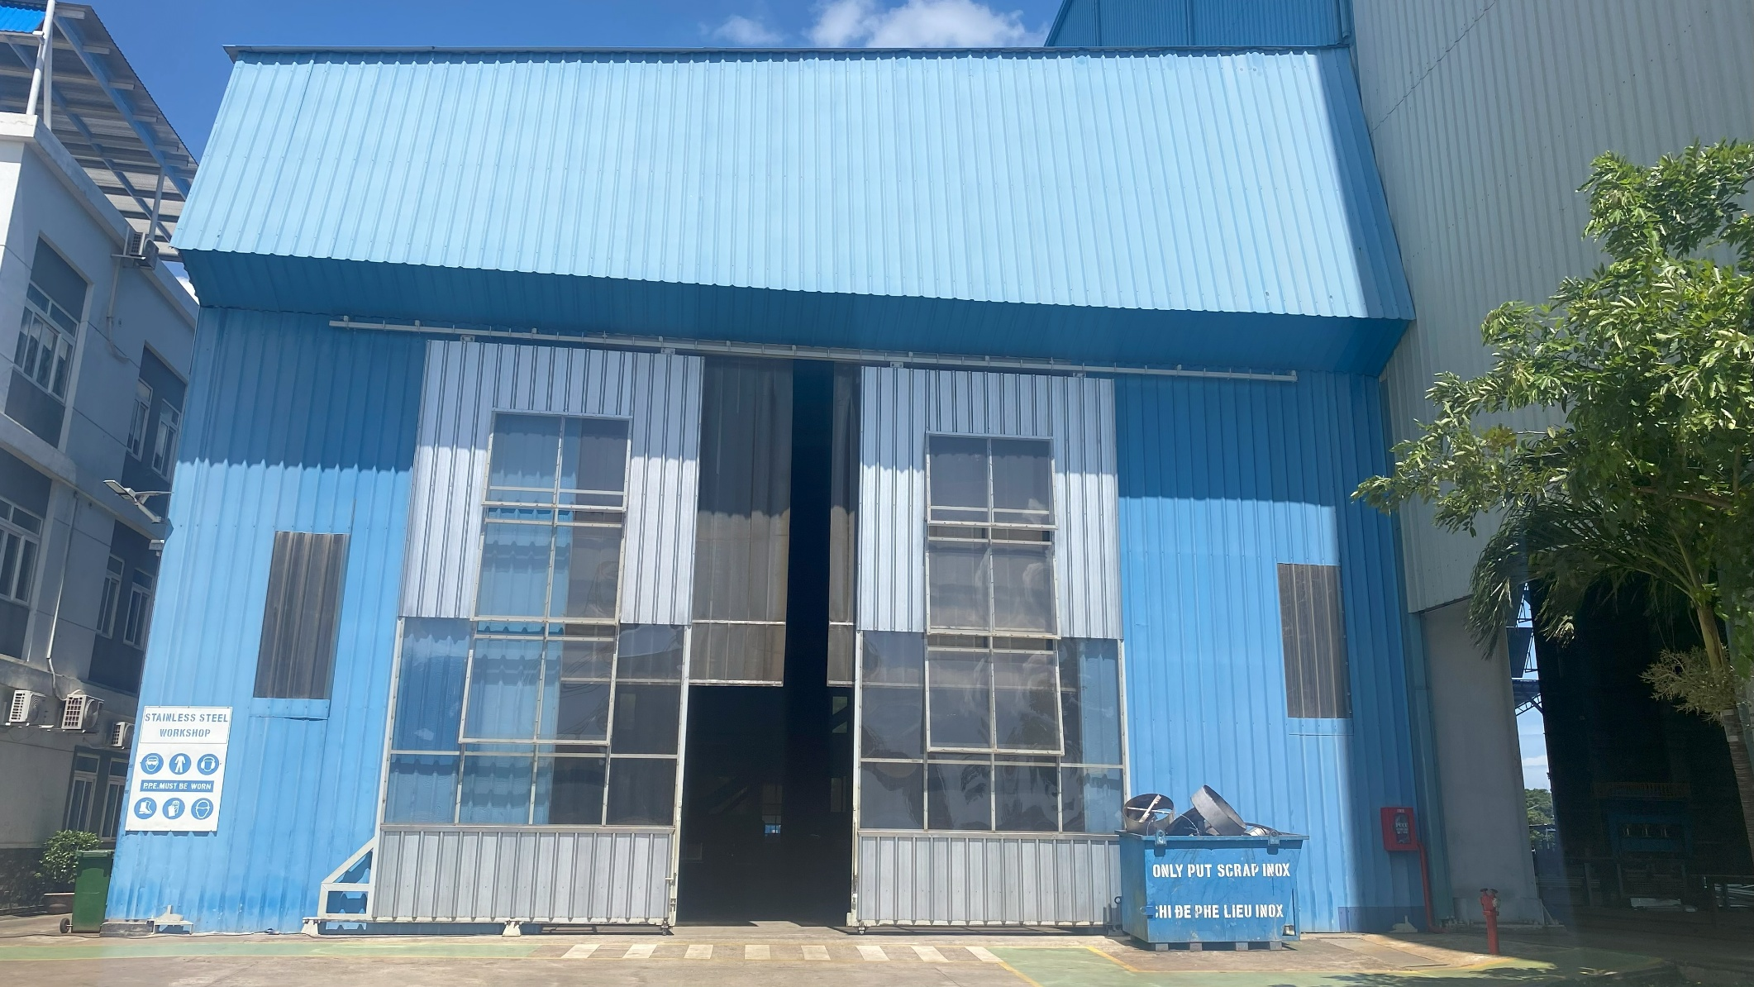
Vina Offshore - Workshop No. 4
Designated Stainless Steel Workshop
Size: 18m (W) x 68m (L) x 9m (H)
Overhead Crane: 1 x 10T and 1 x 5T

Slide 13
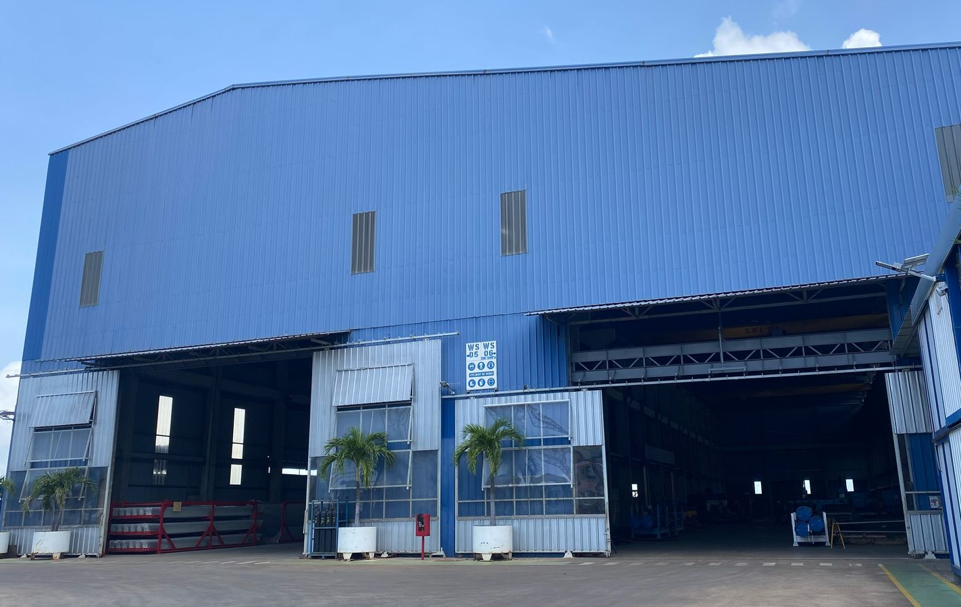
Vina Offshore - Workshop No. 5 & 6
Workshop 5
Size: 19m (W) x 100m (L) x 10m (H)
Overhead Crane: 2 x 10T
Workshop 6
Size: 19m (W) x 100m (L) x 10m (H)
Overhead Crane: 2 x 10T

Slide 14
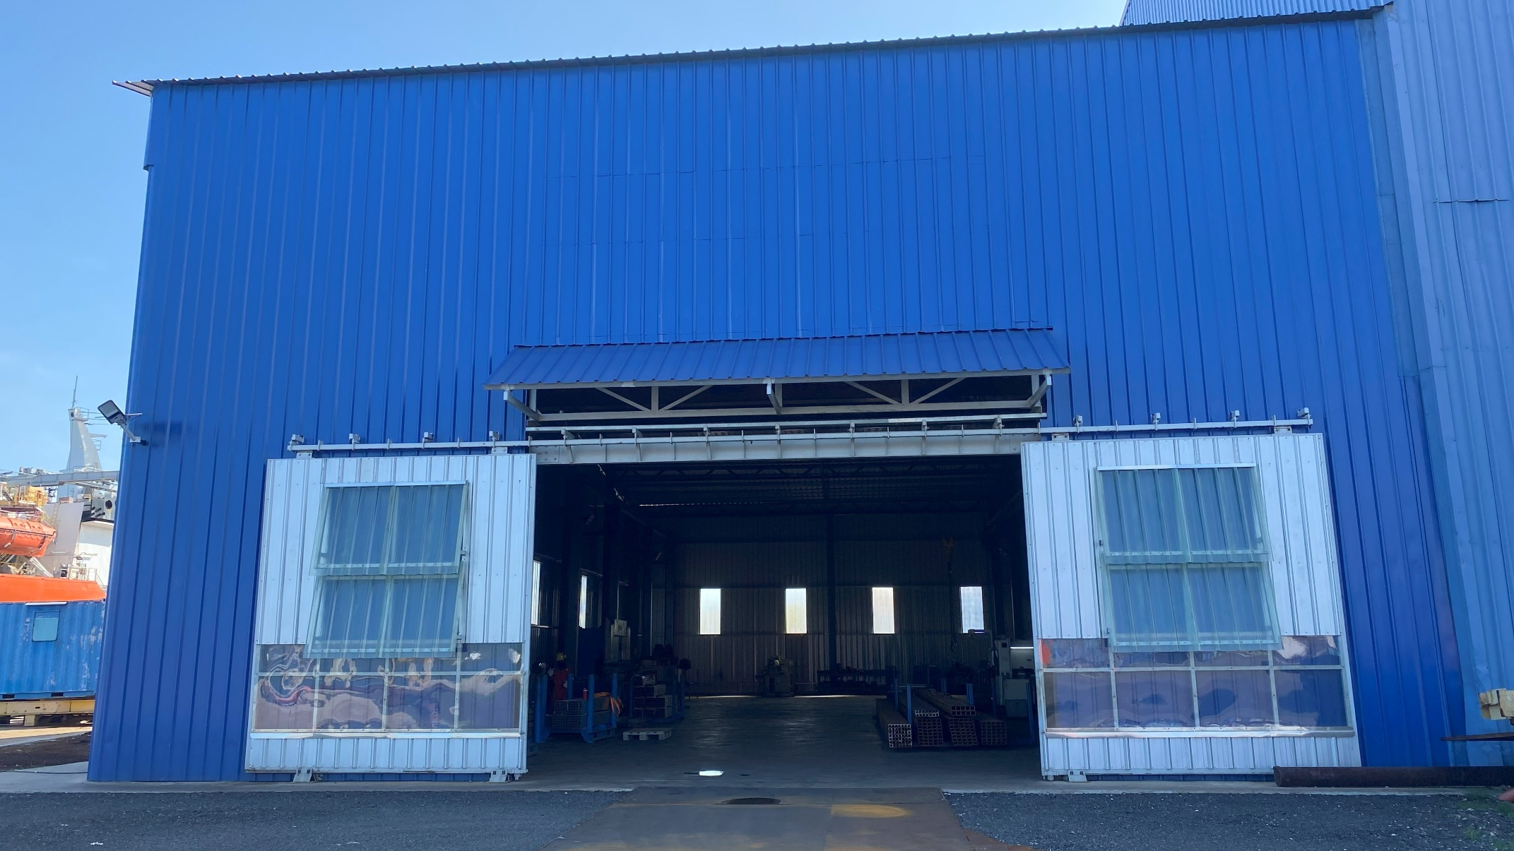
Vina Offshore - Workshop No. 5 & 6 - Extension
Size: 15m (W) x 38m (L) x 7m (H)
Overhead Crane: 2 x 5T

Slide 15
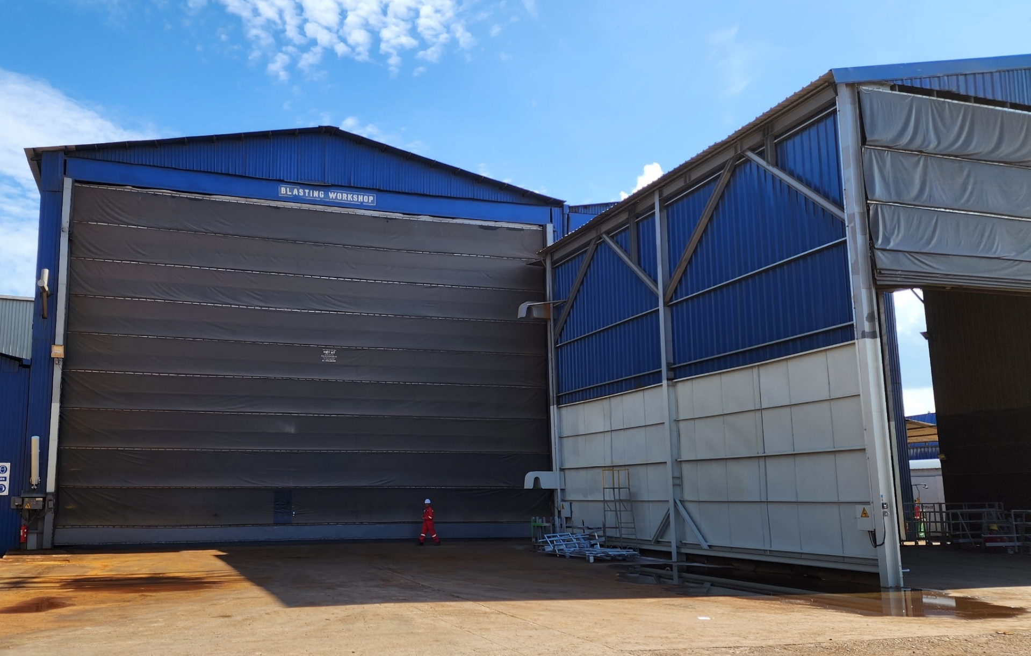
Vina Offshore - Blasting & Painting Workshops
Blasting: 17.4m (L) x 18.2m (W) x 13m (H)
Painting: 17.4m (L) x 14.2m (W) x 13m (H)

Slide 16
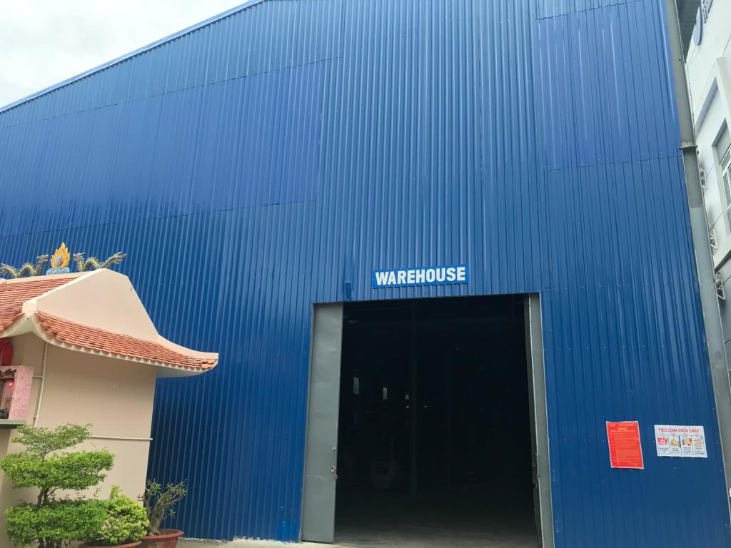
Vina Offshore - Warehouse
Size: 15m (W) x 48m (L) x 9m (H)

Slide 17

Video Tour
2023 Edition
About 5 minutes
Showcase Facilities

Slide 18
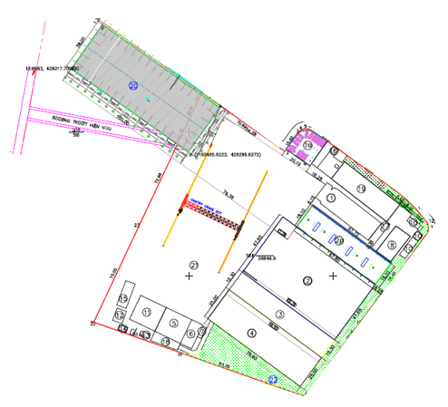
Facilities - Overview
Workshop 6
Workshop 5
Main Gate
Warehouse
Office Building
Blasting & Painting Workshops
Workshop 4 (S/S)
Workshop 1
Workshop 2
Workshop 3

Slide 19
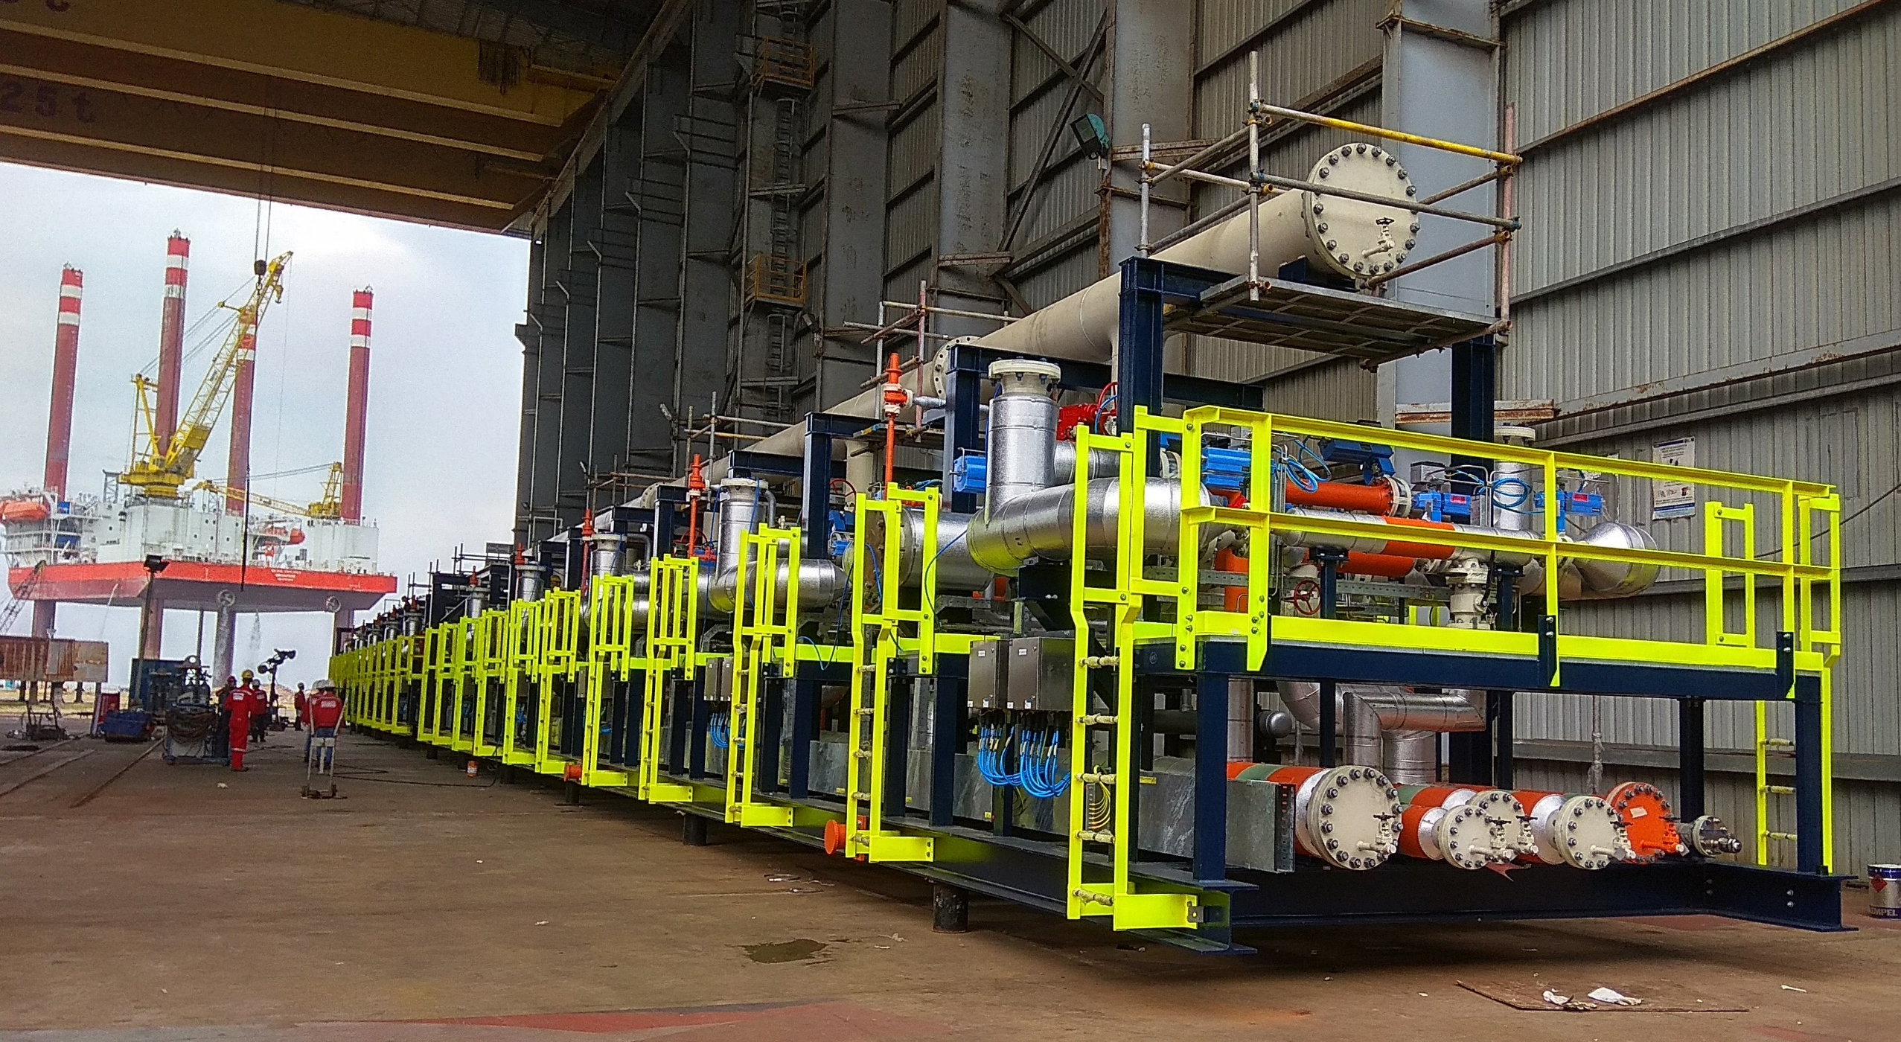
Services of Vina Offshore Engineering
Fabrication & Engineering Solutions
Rigging & Marine Equipment
Pressure Safety Valve Servicing
Rental & Testing Services

Slide 20
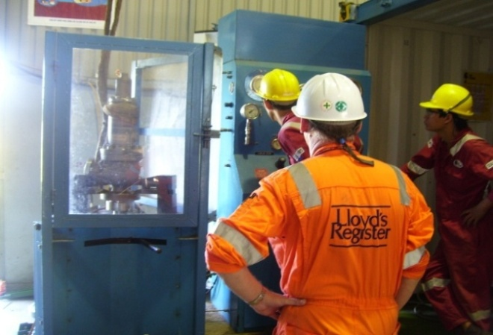
Value-Added Services
Rental Services
Power Generators
Air Compressors
Scaffoldings
Welding Machines
Blasting Pots & Airless Spray Pumps
High Pressure Cleaning Machines
Certified Water Bags & Load Cells
Lifting Equipment Services
Lifting Equipment Inspection & Certification
Loose Lifting Gear Inspection & Certification
Conduct of Testing
Witness of Testing
Attest of Documents
Training Services
Manpower Services
Supervisors
Fitters, Welders, Riggers, Painters
E&I Technicians
Scaffolders
Crane Operators
Valve Services
Valve Servicing
Seat Refurbishment
Calibration
Safety Valve Pop-Test
Valve Re-Certification

Slide 21
Projects Completed By:
Vina Offshore Engineering
Vietnam
www.yhh-marine.com.sg/project-portfolio

Slide 22
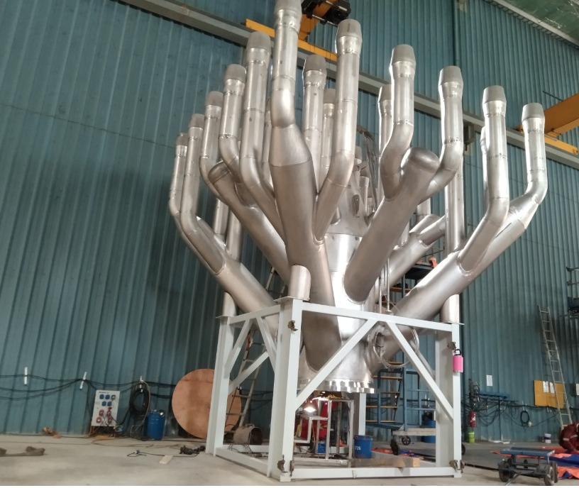
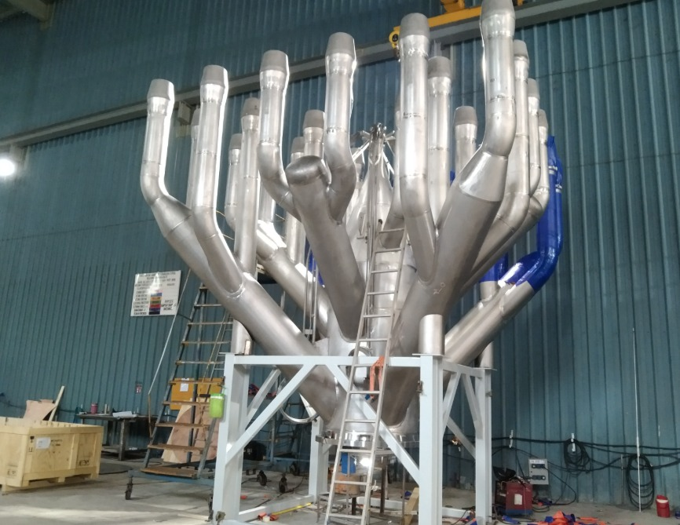
Multi Points HP Flare Tips
Owner: Woodside
Project: Pluto Site B
Weight: 8T & 11T

Slide 23
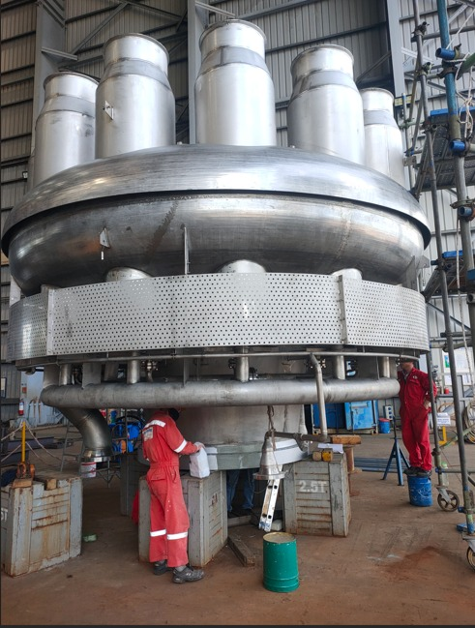
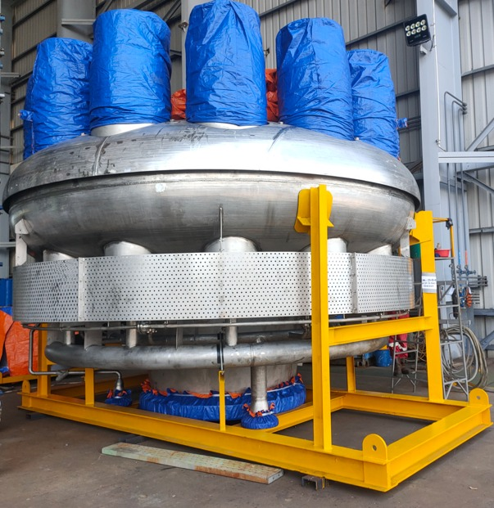
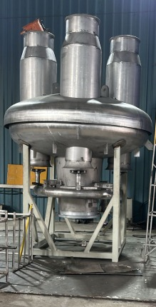
Steam-Assisted Flare Tips
Type: XP-70 (70” Flange)
Owner: ExxonMobil AP
Weight: 20T
Type: XP-30 (30” Flange)
Owner: Singapore Refining Company
Weight: 3T

Slide 24
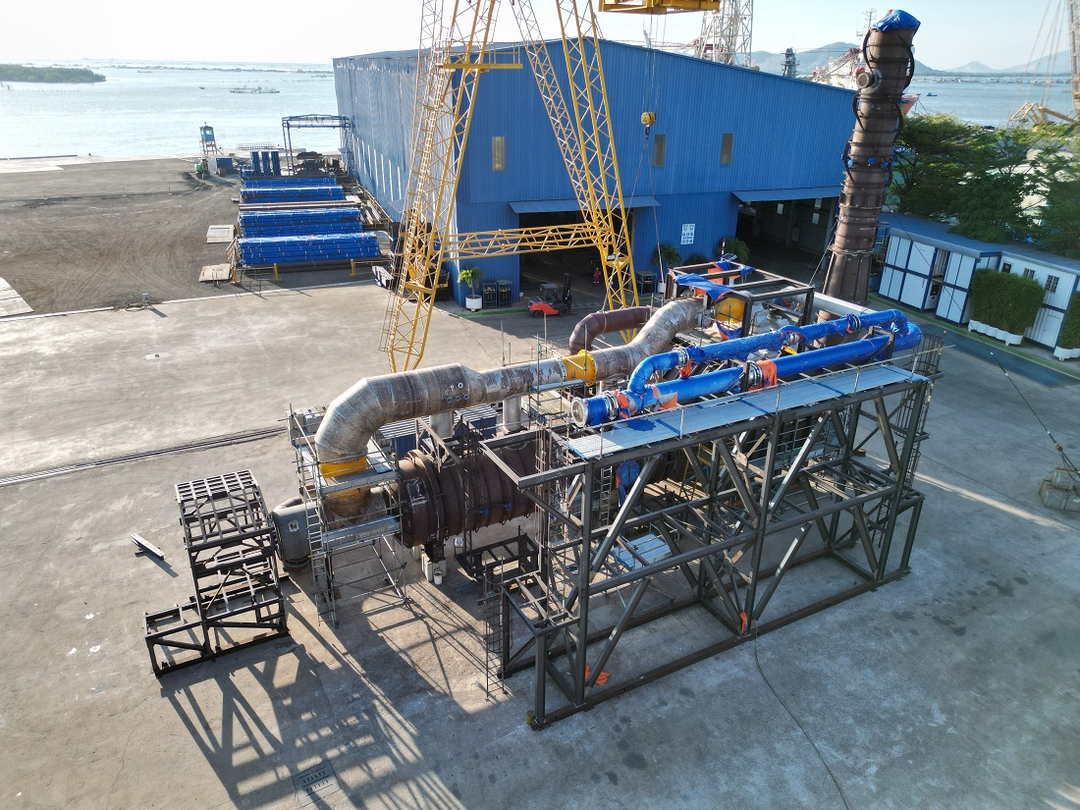
Thermal Oxidizer
Owner: Santos
Project: Darwin LNG (DLNG) Life Extension Project
Weight: 190T

Slide 25
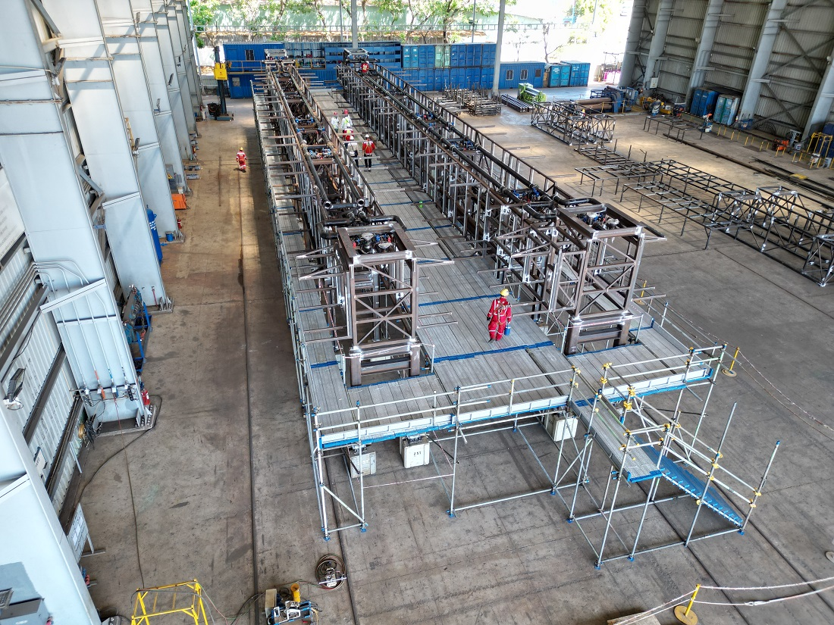
Data Center Module System
Owner: ---
Project: Shiraz Data Center
Weight: Approx. 1,000T

Slide 26
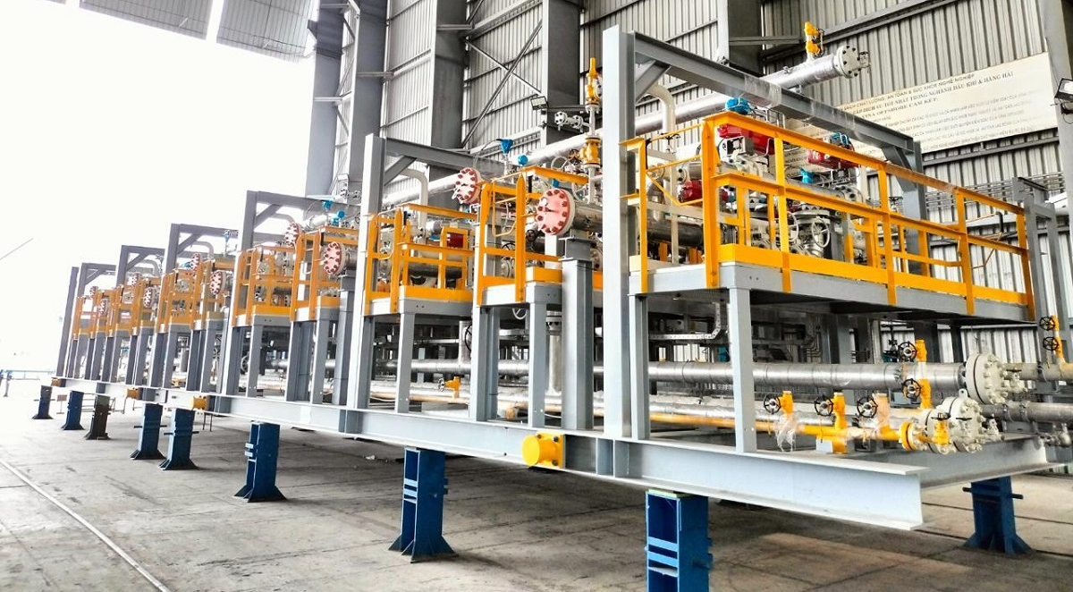
10-Bed PSA Skid
Owner: ExxonMobil
Project: Chemical and Refining Integrated Singapore Plant (CRISP)
Weight: 96T

Slide 27
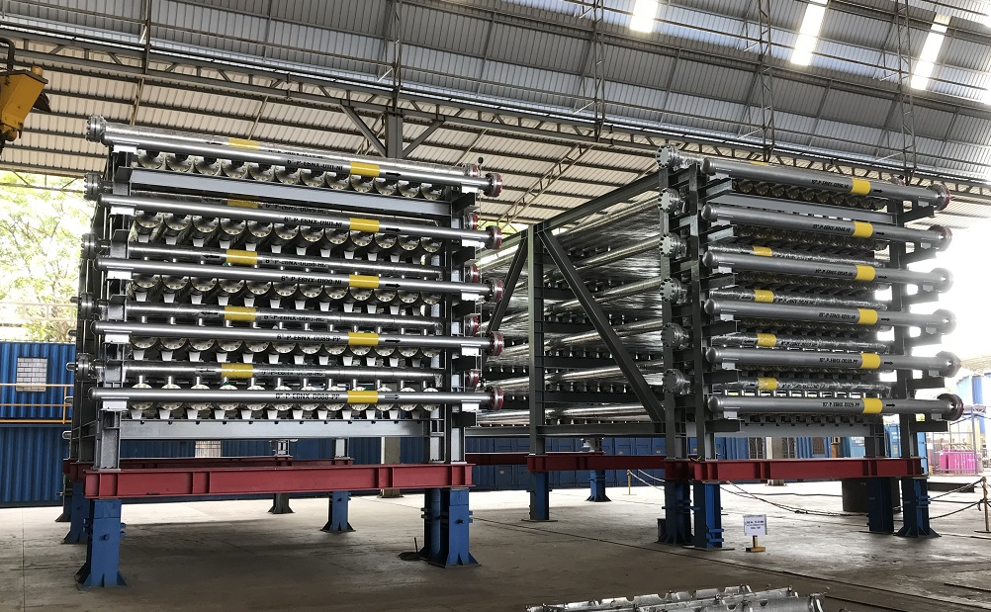
Membrane Skid
Owner: Petrobras
Project: P-82 FPSO
Weight: 150T

Slide 28
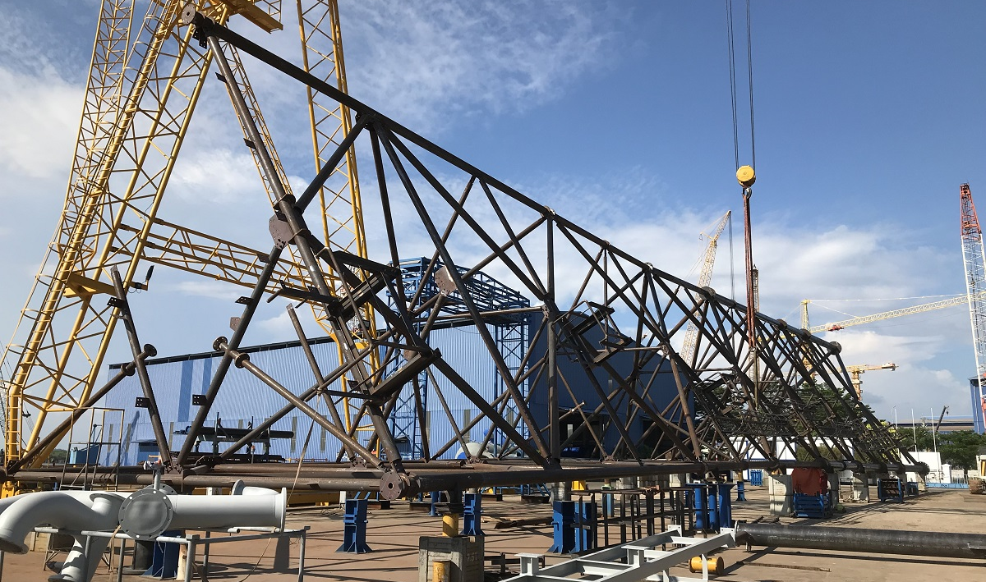
Derrick for LNG Facility
Owner: CPC Corporation
Project: CPC Taichung LNG Terminal Phase 3
Weight: 95T

Slide 29
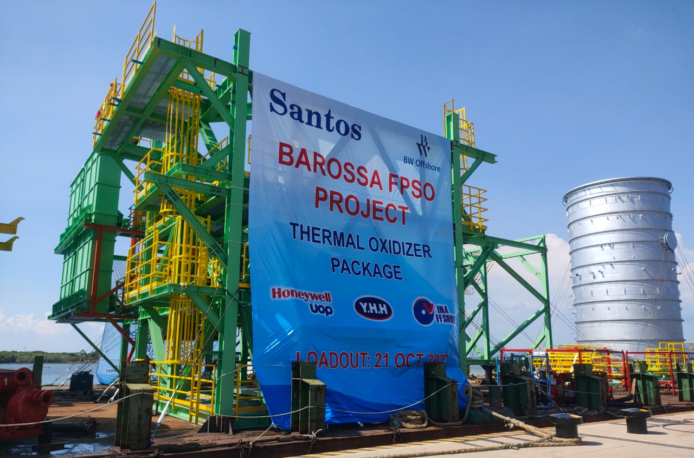
Thermal Oxidizer
Owner: Santos
Project: Barossa FPSO
Total Weight: 420T

Slide 30
CO2 Removal Membrane Package
Owner: Santos
Project: Barossa FPSO
Total Weight: 2,000T

Slide 31
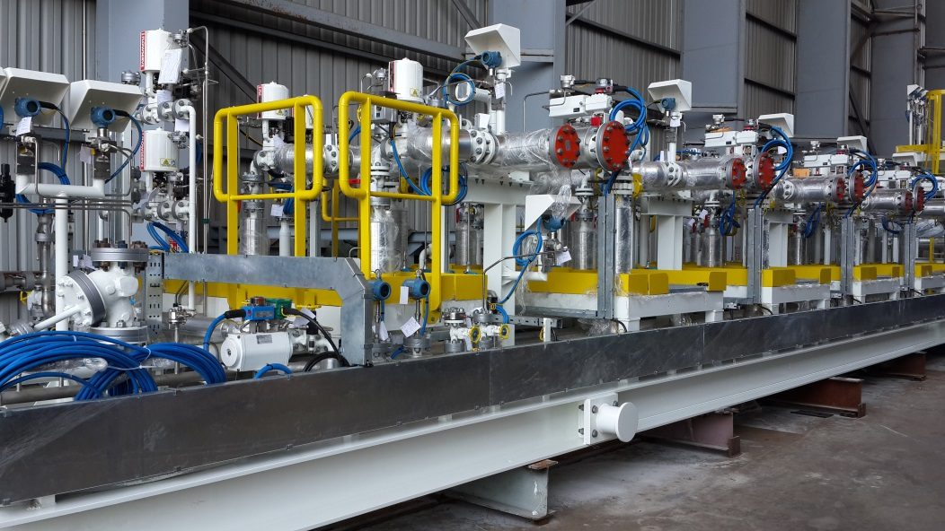
5-Bed Pressure Swing Adsorption (PSA) Skid
Owner: Saudi Aramco
Weight: 32.3T

Slide 32
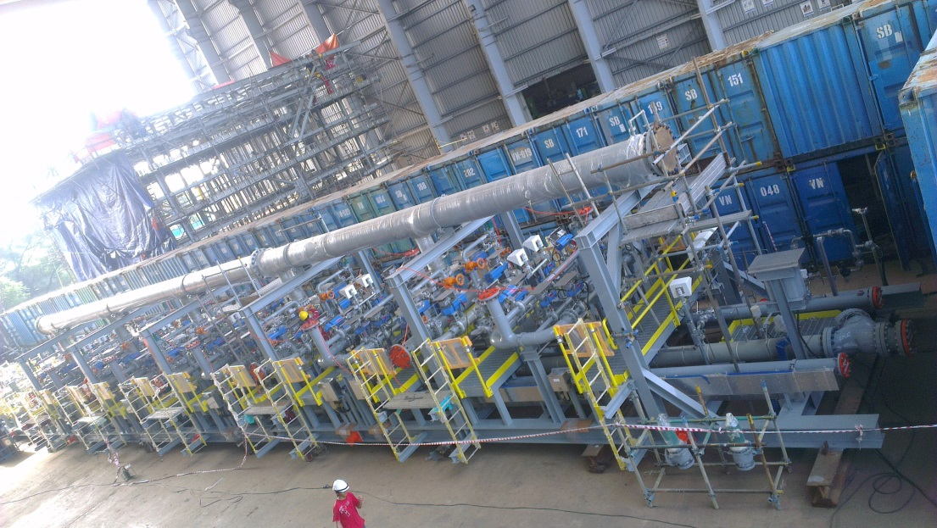
10-Bed Pressure Swing Adsorption (PSA) Skid
Owner: Saudi Aramco
Weight: 105T

Slide 33
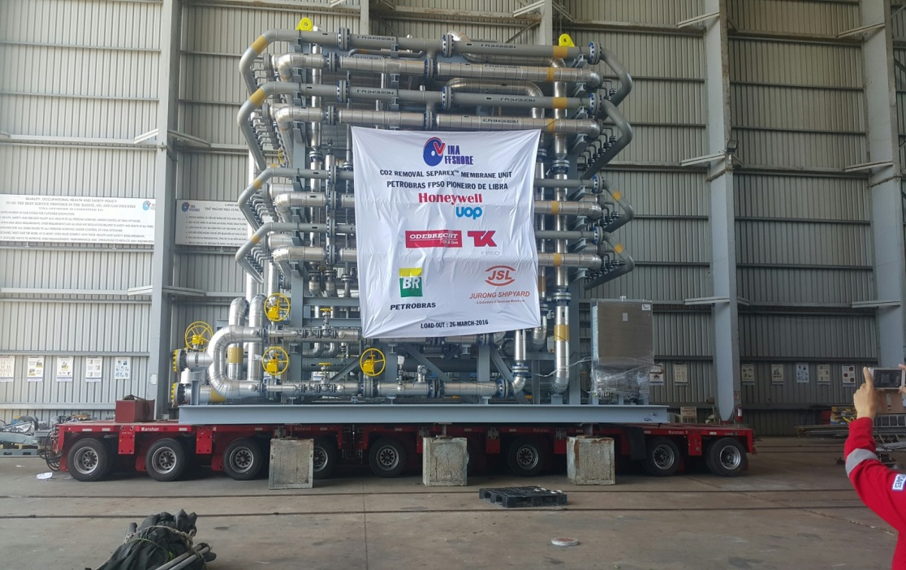
CO2 Removal Membrane Skid
Owner: Petrobras
Weight: 80.6T

Slide 34
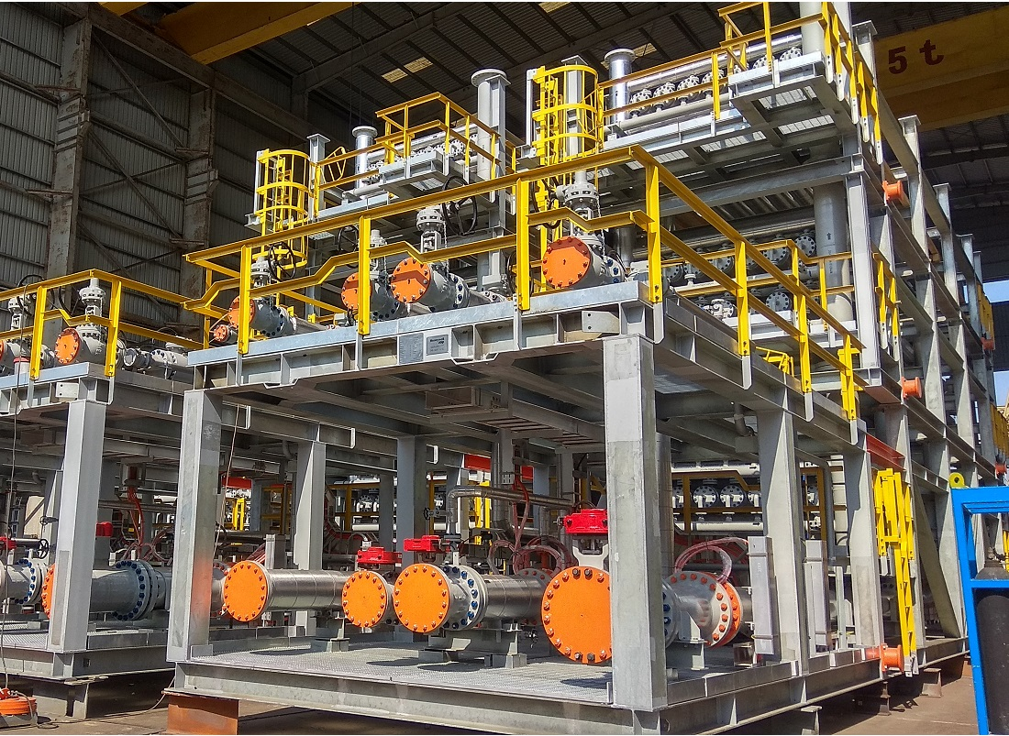
10-Bed Pressure Swing Adsorption (PSA) Skid
Owner: ADNOC
Project: Crude Flexibility Project
Skid Weight: 35T

Slide 35
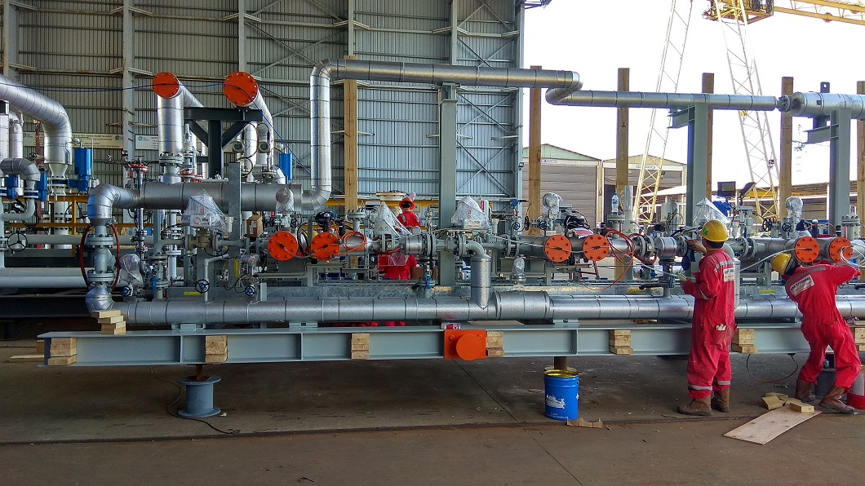
4-Bed Pressure Swing Adsorption (PSA) Skid
Owner: ME Global
Weight: 6T

Slide 36
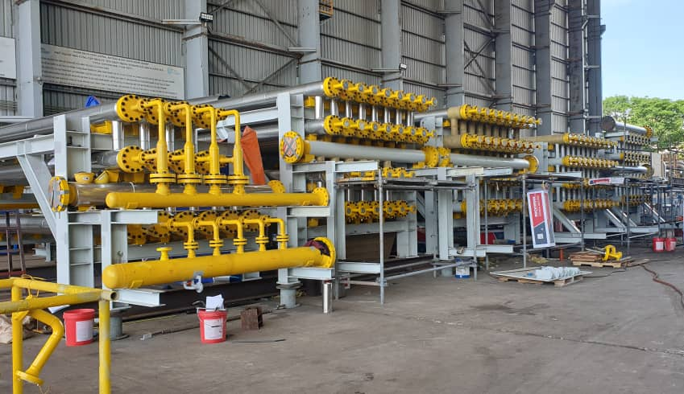
Membrane Skid
Owner: Petrobras
Project: FPSO Guanabara MV31

Slide 37
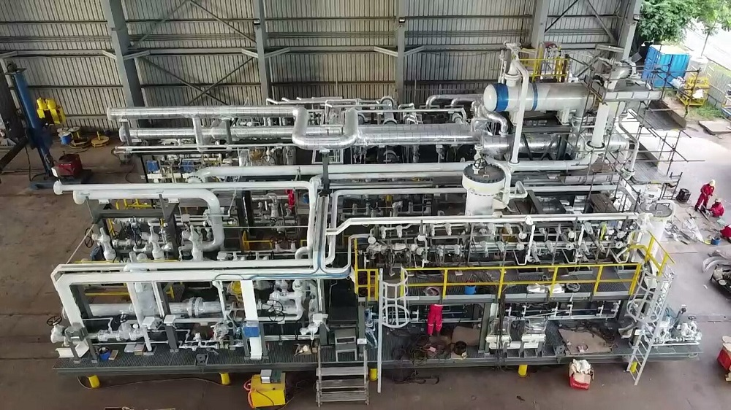
Membrane Skid
Project: Takreer Refinery
Skid Weight: 75T

Slide 38
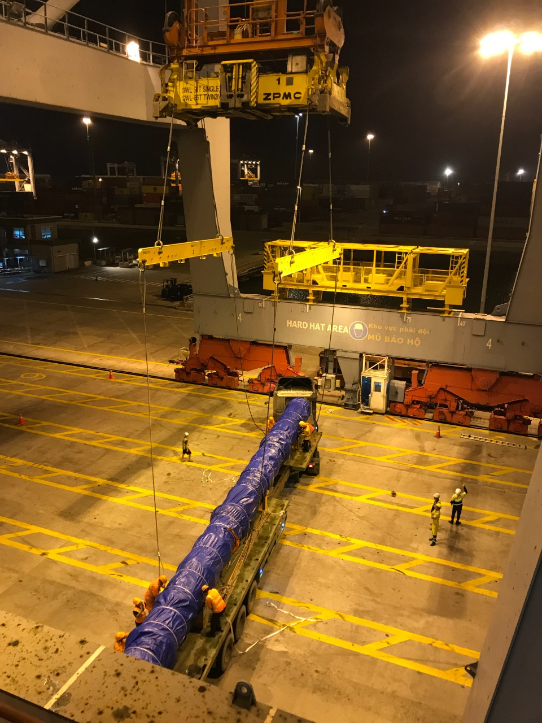
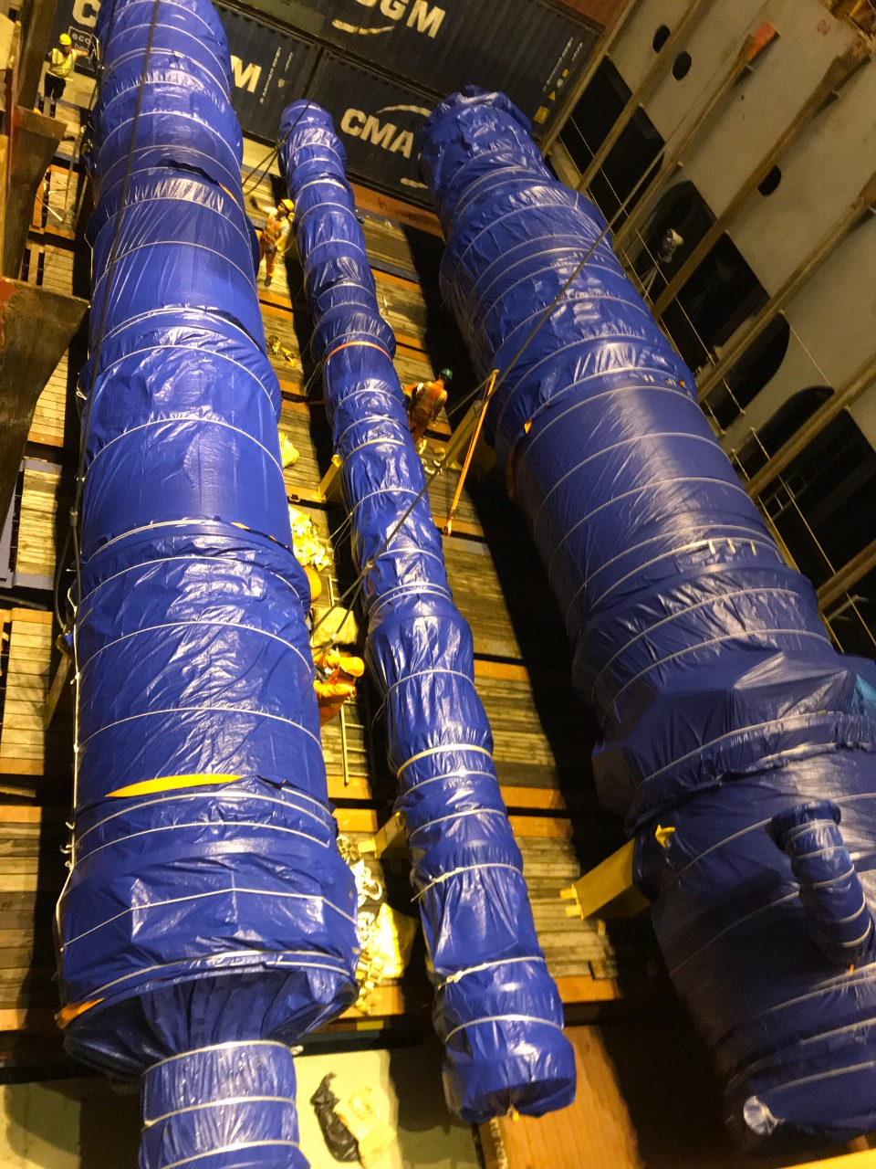
Thermal Oxidizer
Owner: Phillips 66

Slide 39
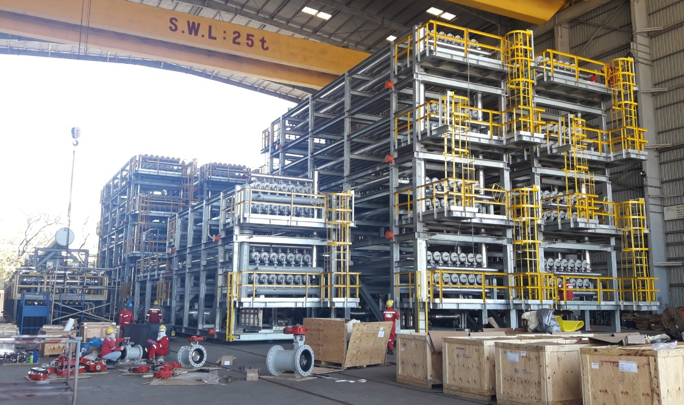
Membrane Skid
Owner: Cepu-Pertamina
Weight: 900T

Slide 40
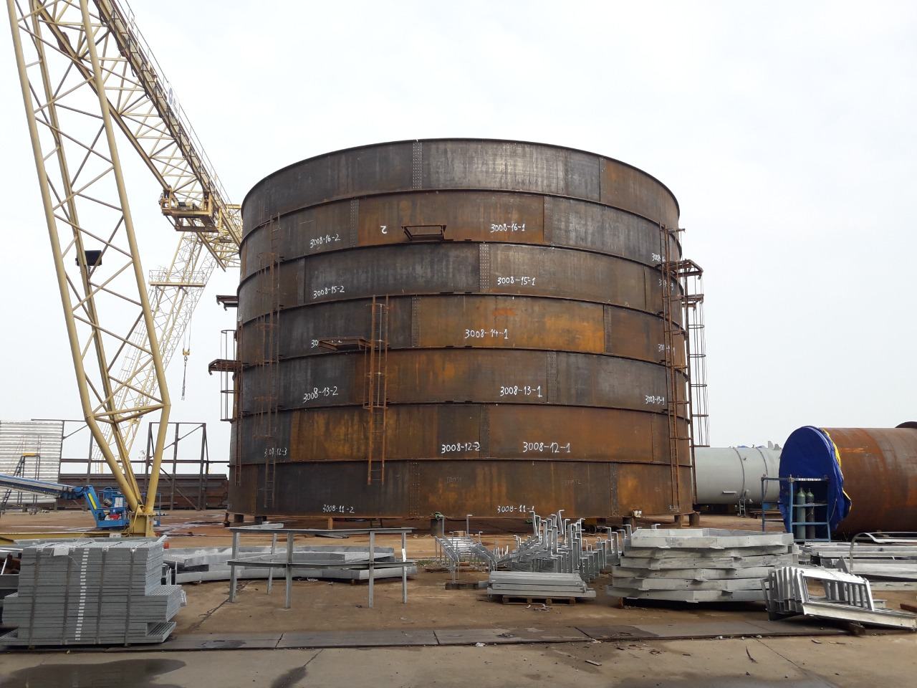
Total Enclosed Ground Flare
Owner: Chandra Asri

Slide 41
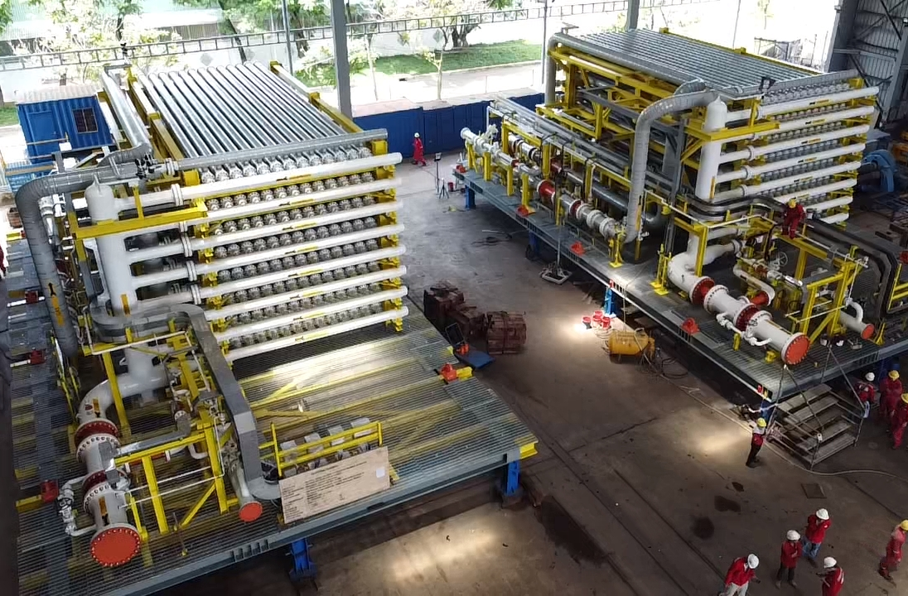
Acid Gas Removal Unit
Owner: Petronas Carigali
Project: Kasawari Gas Deveopment
Skid Weight: 600T

Slide 42
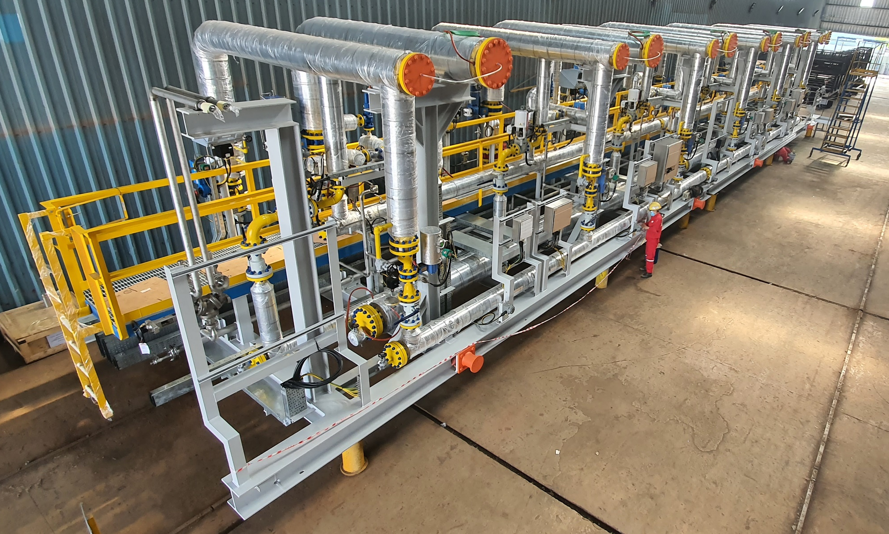
6-Bed Pressure Swing Adsorption (PSA) Skid
Project: NZNP Plant Oil Refinery
Skid Weight: 53T

Slide 43
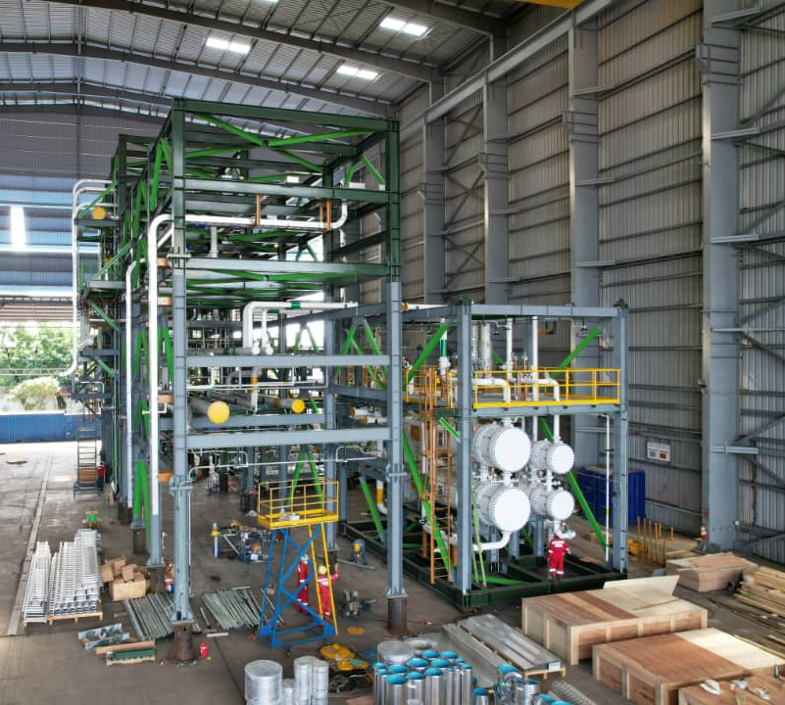
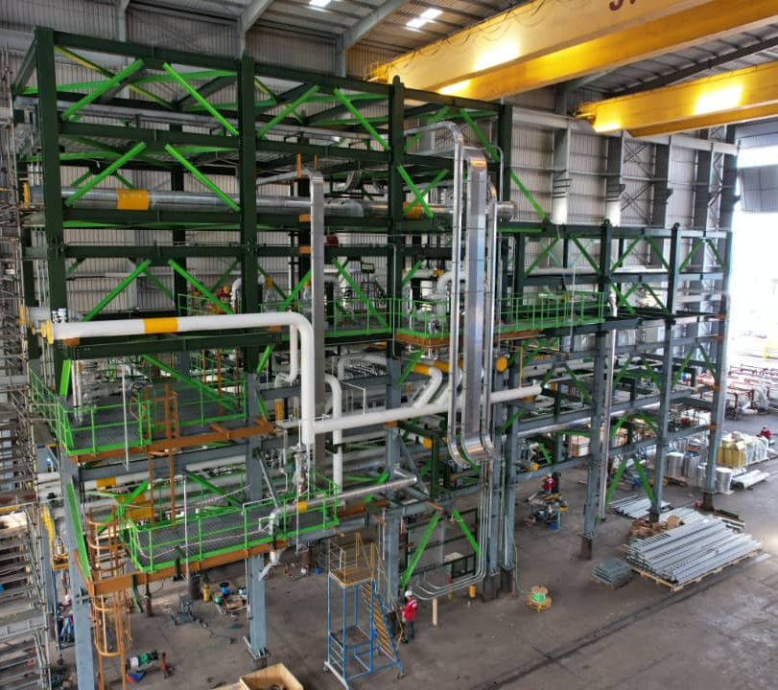
Recovery Max Modular Solution
Owner: PEMEX
Project: Pemex Recovery Max
Skid Weight: 280T

Slide 44
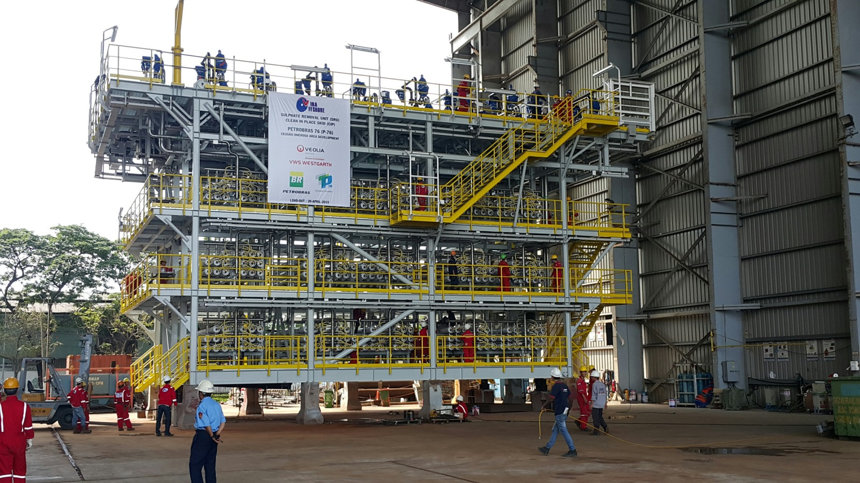
Sulphate Recovery Unit
Owner: Petrobras P76
Weight: 160T

Slide 45
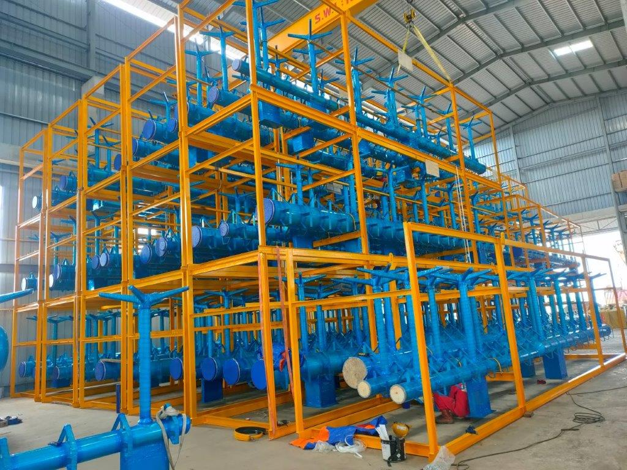
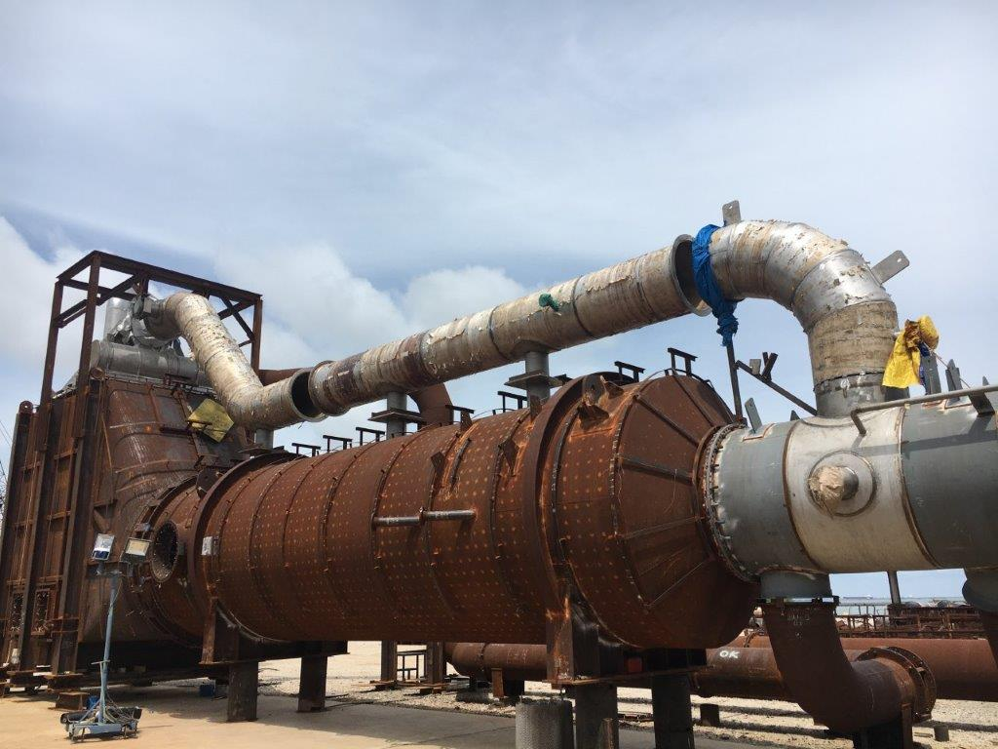
Open Ground Flare Packages
Include Header, Runner, Thermal Oxidizer, Preheater, Flare Stack
Owner: Golden Pass LNG Terminal
Project Name: Golden Pass LNG Export
Weight: 2,700 Tons

Slide 46
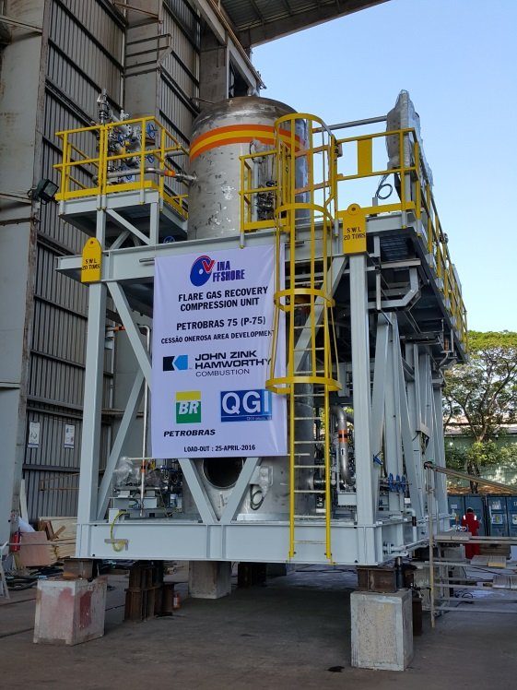

Flare Gas Recovery Compression Skid
Owner: Petrobras P75 & P77
Weight: 67T

Slide 47

Ground Flare
Owner: Fluor
Project: Lyondell
Weight: 297T

Slide 48

Thermal Oxidizer
Owner: Exxon-SABIC
Project: Chiyoda GYO Project
Weight: 152T

Slide 49

Large Enclosed Ground Flare
Owner: JG Summit
Weight: 360T

Slide 50


Merox Flare Stack and Liquid Seal
Owner: Fluor USA
Weight: 10T

Slide 51

Foundation Jacket Grillages on HTV
Owner: Jan De Nul Group, Taiwan Power Company
Project: Greater Changhua Project
Weight: 1,470T

Slide 52
Vina Offshore Engineering’s
Experience On:
Insulation & Jacketing Materials

Slide 53
Insulation Materials
Mineral Wool
Projects: Cepu ● MPCL ● Kasawari ● Pemex ● Lotte
Cellar Glass
Projects: MPCL ● Kasawari ● Barossa
PIR Cold Insulation
Projects: Kasawari
Aerogel Insulation
Projects: Petrobras P-82

Slide 54
Jacketing Materials
Aluminium
Projects: Cepu ● MPCL ● Pemex ● Lotte
Stainless Steel
Projects: Kasawari ● Petrobras P-82
Glass Reinforced Plastic
Projects: Kasawari
ULVA
Projects: Barossa

Slide 55


Slide 56


Slide 57


Business Address
Y.H.H Marine Engineering Pte Ltd
2, Buroh Crescent, #01-17
Ace@Buroh, Singapore 627546
Tel: +65 6368 0350
Fax: +65 6365 6807
Vina Offshore Engineering Co., Ltd.
Road No. 5, Dong Xuyen Industrial Park
Rach Dua Ward, Ho Chi Minh City
S.R. Vietnam, 70000
Tel: +84 254 3832 888
Fax: +84 254 3832 828
yhh@yhh-marine.com.sg
www.yhh-marine.com.sg
service@vnoffshore.com.vn www.vina-offshore.com

